Slide 1
ENEL 585 – Project Orientation
Lab 0
JT Luterbach (TA)
Department of Electrical & Software Engineering
September 8, 2026

Slide 2
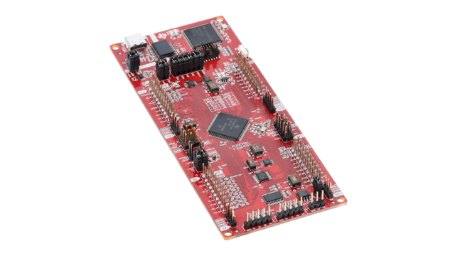
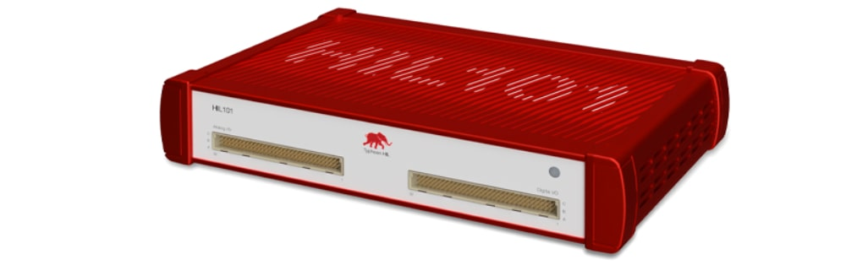
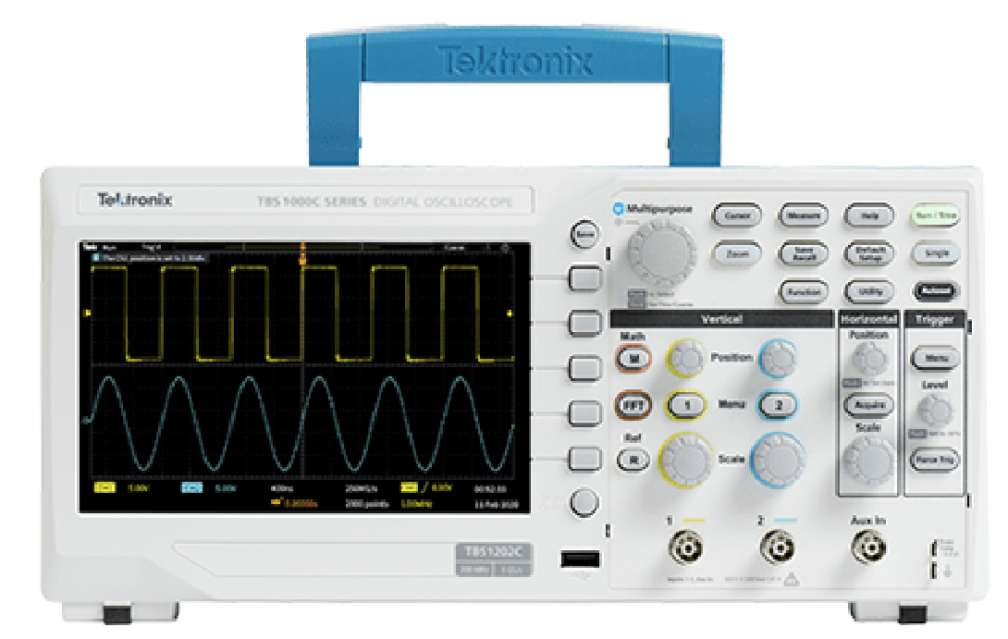
Introduction
Today’s purpose: Gain experience with some of the equipment necessary to complete the ENEL 585 final project (and labs)
  Learn how to program a Texas Instruments Launchpad as a power electronics controller
  Learn how to run a TyphoonHIL real-time converter simulation
  Refresh your oscilloscope skills

Slide 3
Background
Key components within a power electronics project:
  Converter hardware
    Switches, inductors, capacitors, resistors, transformers
  Controller
    Execute the control algorithm, process sensor measurements, generate gating signals
  Auxiliary circuitry
    Gate drivers, sensors, filters, power supplies
  Thermal management
    Heat sinks, cables, PCB traces, fans

Slide 4
Hardware-In-the-Loop (HIL) validation
Power electronics prototypes can be expensive and easily damaged if the control algorithm is not right
  For example: Easy to unintentionally short the power supply if not careful
HIL simulators:
  receive gating signals from the controller
  output actual voltages representing the converter’s sensor outputs
Controller’s can be reliably designed on the HIL without risking damaging equipment
I/V measurements
Gating signals

Slide 5
Key differences between HIL and hardware
HIL assumes lossless conversion
  Actual hardware has switching and conduction losses
HIL measurement outputs are high-bandwidth and accurate
  Actual sensors can have error and noise
  Actual sensors might require adjusting the measurement scaling with trial-and-error
HIL circuit parameters are exact and consistent
  Actual resistances, inductances, and capacitances are less precise and dependent of other variables like temperature, frequency, etc

Slide 6
Today’s tasks
Use the three provide files to run a HIL real-time simulation of a buck converter
  .plecs file: Contains the control algorithm, used to program the launchpad
  .tse file: Contains the converter HIL schematic
  .cus file: Contains the HIL SCADA panel
For marks:
  One group member sets up the TyphoonHIL simulation for their group
  Each group member must program the launchpad and show an instructor/TA the inductor current and output voltage waveforms on an oscilloscope

Slide 7
Today’s tasks
Bonus (not for marks):
  As a group, use the oscilloscope to determine the converter’s settling time when the output resistance changes from 10 to 5 ohms with the input voltage set to 20V and the desired output voltage set to 10V.

Slide 8
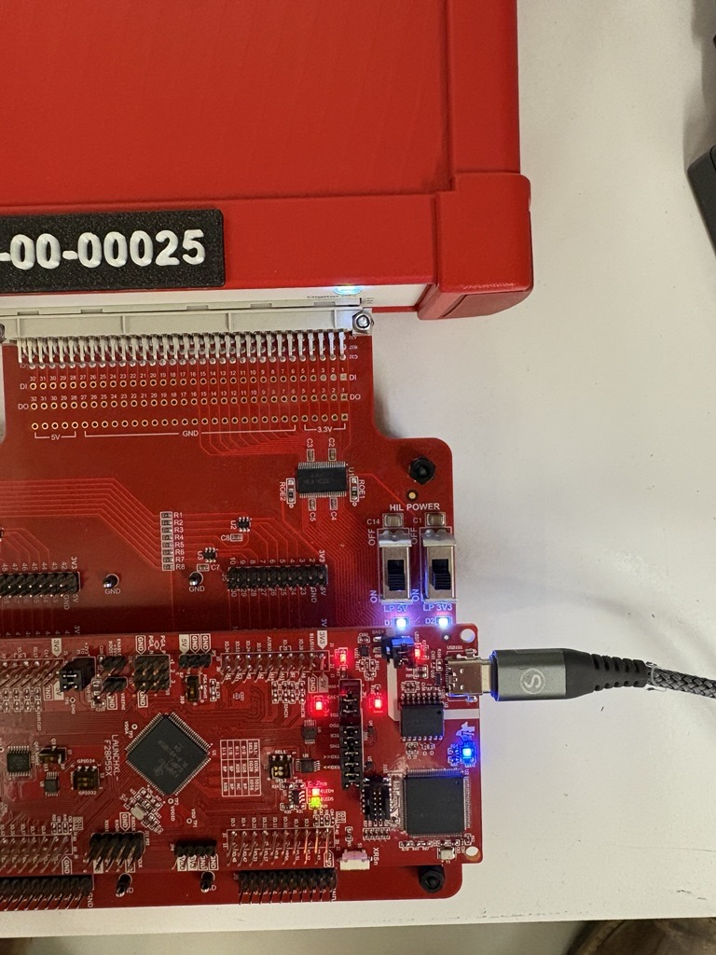
How-to: Hardware
HIL101 units should be powered on
Send power to the launchpad using the 5V and 3.3V switches
  Do not change anything on the launchpad itself
You need to set up the oscilloscope yourself, specifically the scaling

Slide 9
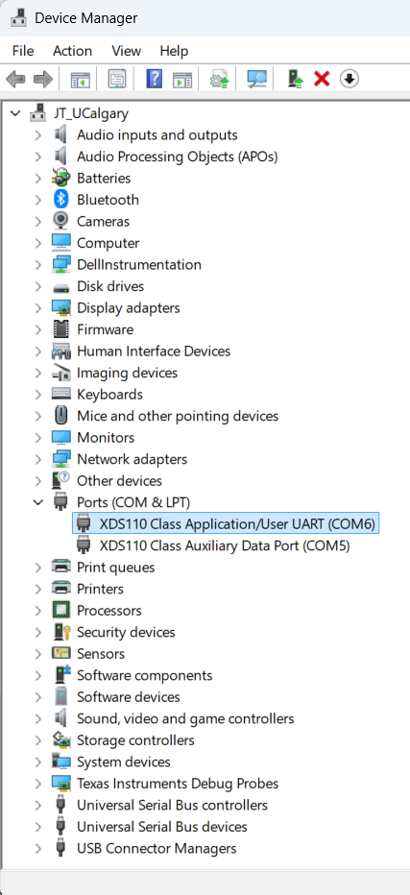
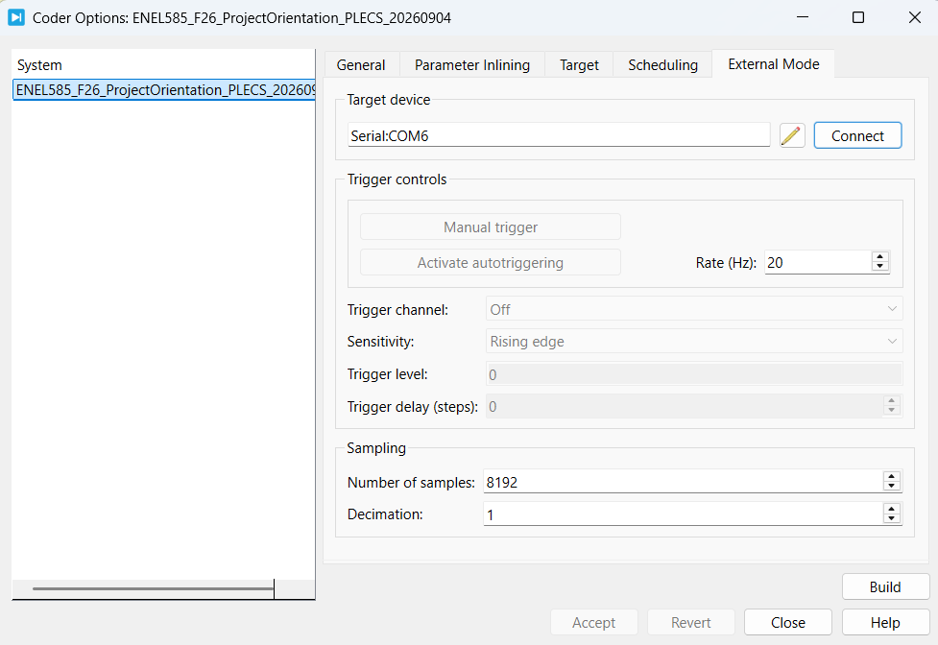
How-to: PLECS
Open model in PLECS
Go to “Coder”
Press “Build” and wait until MCU is flashed
Go to “External Mode”
Check Target device port
  Check Device Manager on your laptop
Press “Connect”
Press “Activate autotriggering”
Double-tap the enable-switch to turn-on

Slide 10
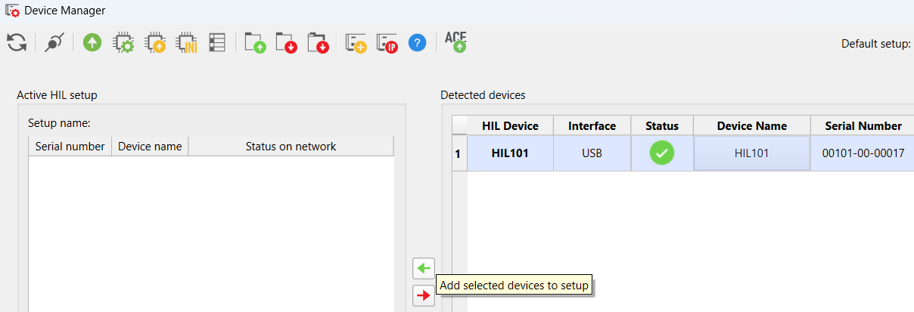
How-to: TyphoonHIL
Connect to the HIL device in device manager
Open schematic editor
Compile provided model
Select provided panel file
Run the simulation

